Slide 1
IT306
Module 9
Map (HashMap , Hashtable)

Slide 2
Map

Slide 3
The Map Interface
An object that maps keys to values.
A map cannot contain duplicate keys; each key can map to at most one value.
This interface takes the place of the Dictionary class, which was a totally abstract class rather than an interface:
public abstract class Dictionary<K,V> extends Object
interface MAP <K,V>
…
A conceptual illustration of a map
key 1
val 1
Dictionary<Flight, Flight> dictionary = new Hashtable<Flight, Flight>();
key 2
val2
…
…
key n
val n
Notes:
This lecture explains the Map interface and its subclasses in Java.
A Map is a data structure that contains values based on key i.e., key and value pair.
In a Map, keys are only unique keys.
Map is useful for searching, updating, or deleting elements on the basis of key. Hence, map works as a look up table with very fast access time. The Access Time is in fact O(1) , because it is on the basis of unique key.
The Map interface includes methods for basic operations (such as put, get, remove, containsKey, containsValue, size, and empty), bulk operations (such as putAll and clear), and collection views (such as keySet, entrySet, and values).

Slide 4
Map Interface cont.
Map is designed to efficiently store and retrieve values based on a unique search key for each entry.
A map stores key-value pairs (k,v), which we call entries.
Maps are also known as Associative arrays; the entry’s key serves like an index.
put(key , value): add a new element.
A conceptual illustration of a map
java.util.*;
…
Map<Double, Flight> flights = new HashMap<Double, Flight>();
Random r = new Random(100000) ;
flights.put(r.nextDouble(), new Flight("KM120", 200, "Tom Jason", true));
flights.put(r.nextDouble(), new Flight("DB304", 228, "Mina Brown", false));
flights.put(r.nextDouble(), new Flight("EM110", 110, "Jon Thomas", false));
key 1
val 1
key 2
val2
…
…
key n
val n
Inserting new entries to the map
Notes:
The entry’s key serves somewhat like an index.

Slide 5
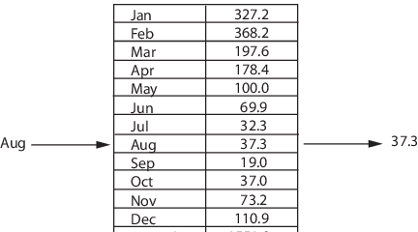
The Map Interface
Key
Value
Entry
value
Unique Key
<“Aug”,37.3>
Map <String,Integer>
https://www.mathworks.com/help/matlab/matlab_prog/overview-of-the-map-data-structure.html?requestedDomain=www.mathworks.com
Notes:
Each key and value pair is known as “Entry”. Therefore, a map is a set or collection of entries.
For example …
Map offers a flexible means of indexing data. The key and value fields can only be reference types.

Slide 6
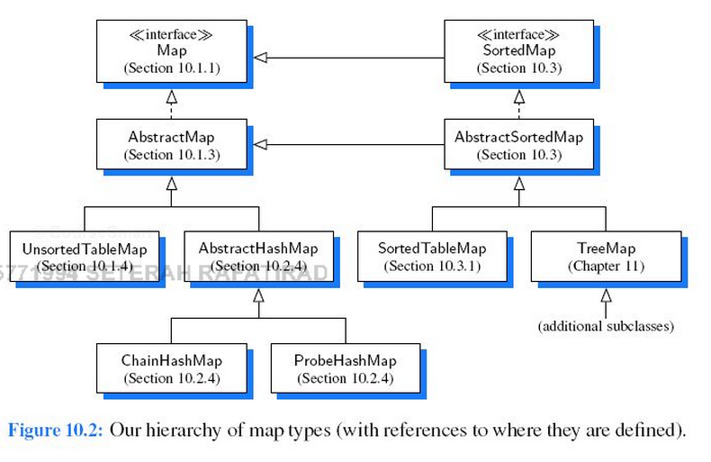
Map as an Abstract Type
Notes:
Map as Abstract Type

Slide 7
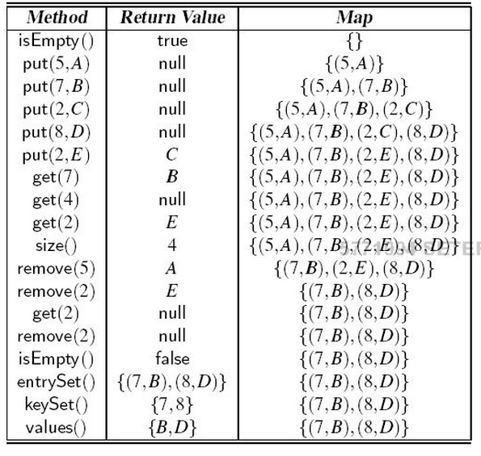
Map Operations
null

Slide 8
Entry<key,value>
Unique key
keys are not restricted to numeric reference types.
Map <Object, Object> e.g., Map<School,Student>
Important methods in Map interface
public void put(Object key, Object value) : to insert an entry in this map
public void putAll(Map map) : to insert a specified map in this map
public Object get(Object key) : to return the value for the specified key
public Object remove(Object key) : to delete the entry for the specified key
public boolean containsKey(Object key) : to search the specified key in this map
public Set keySet() : returns the Set view containing all the keys
public Set entrySet() : returns the Set view containing al the entries (i.e., keys and values)
Important Methods in Map.Entry interface
public Object getKey() : is used to obtain key
public Object getValue() : is used to obtain value
Notes:
Examine the methods using the example in the previous slide

Slide 9
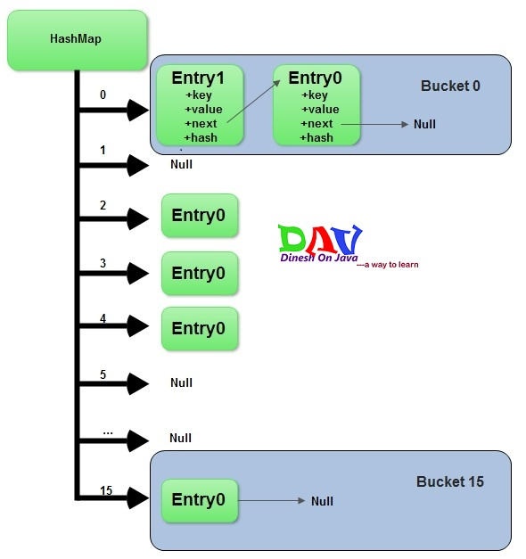
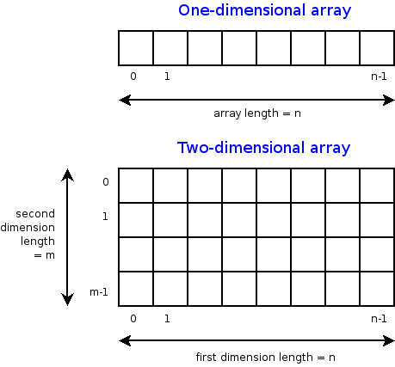
Map vs. Array
Standard array requires numeric index
Map key is either numeric or object.
Map key does not directly designate a position within the structure.

Slide 10
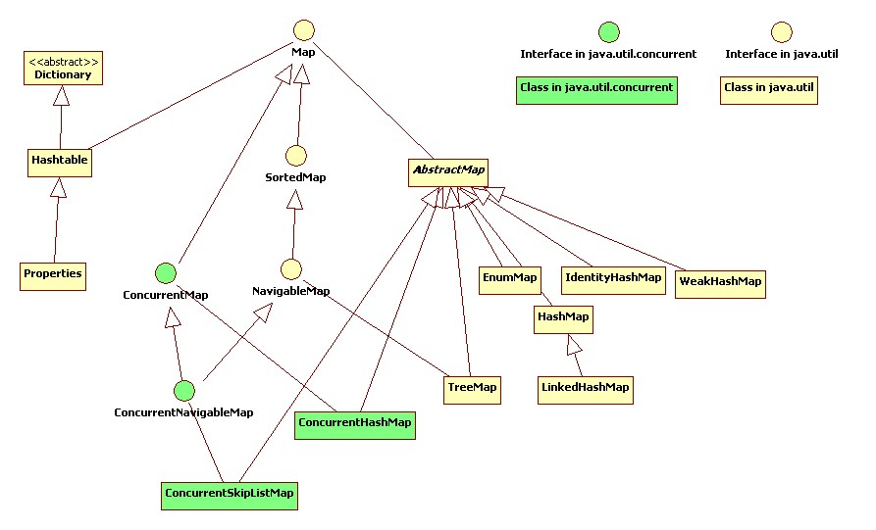
HashMap & Hashtable

Slide 11
HashMap
public class HashMap<K,V> extends AbstractMap<K,V> implements Map<K,V>, Cloneable, Serializable
A HashMap permits null values and the null key.
Constant time performance for get and put operations
The HashMap class is roughly equivalent to Hashtable , except that:
1) it is unsynchronized
2) permits nulls
Notes:
Hashmap is a java class that implements the Map interface. This implementation provides all of the optional operations of the Map interface.
unSynchronized means multiple threads can modify a HashMap at one point of time.

Slide 12
How does HashMap work Internally?
Remember: an entry is a key-value pair.
Step1: Calculate hashcode for key-value mapping.
Step2: Calculate position hashcode % (arrayLength-1) , where element should be placed. This is similar to bucket number.
Step3: Entries with duplicated keys are overwritten in hashmap.
Step4: A new entry is added to the bucket. If bucket has already at least one element, the new element gets added and placed in the first position in the bucket. Its next field refers to the old element. (Analogy: adding to the beginning of a LinkedList)
Array of buckets (array of pointers to multiple linkedlists)
Notes:
A hashmap is a simple, yet powerful way to store and access data.
Hashcode is used for key-value mapping. A hash function automatically calculates the hashcode for this mapping; hash value maps an entry to a bucket.
A Hashmap stores data into multiple unidirectional or singly linked lists of entries, called buckets. Each linkedlist represents a bucket so in that sense, a hashmap is an array of buckets or bins, where all keys with the same hash value are put in the same bucket or linked list. Therefore, entries are linked as in a singly linked list. This is demonstrated in this figure with an arrow from entry 1 for instance, to entry 2 where these are nodes of the Bucket 0 linked list.
Say this after “step 4”: Hashmap does not have order at any time, even when not rehashing.

Slide 13
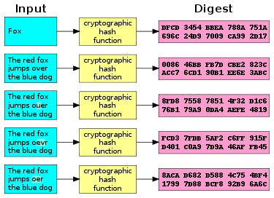
Cryptographic Hash Function
Notes:
a cryptographic hash function takes a message as input and returns a fixed-size alphanumeric string, called a hash value or “message digest”, “or “digital finger print” , or “checksum”.

Slide 14
Hash Function
Hash functions are primarily used in HashMaps and Hashtables, to quickly locate a data record (e.g., a dictionary definition) given its search key (the headword).
Hash function is used to map a search key to an index; the index gives the place in the HashMap where the corresponding record should be stored.
The domain of a hash function (the set of search keys) is larger than its range (the number of different table indexes)
It maps several different keys to the same index. Hence, each slot of a HashMap is associated with (implicitly or explicitly) a set of records, rather than a single record. For this reason, each slot of a HashMap is often called a “bucket”, and hash values are also called “bucket indices”.
Hashtable works in the similar way except slight differences explained later.
Goal of hash function, h, is to map each key k to an index in the range [0,N-1].
Study class HashMap<K,V>: http://docs.oracle.com/javase/7/docs/api/java/util/HashMap.html

Slide 15
HashMap Capacity
An instance of a HashMap has two parameters that affect its performance:
1) initial capacity ,
2) load factor.
Capacity is the number of buckets in the HashMap.
Initial capacity is the capacity at the time the HashMap is created.
Load factor is a measure of how full a HashMap is allowed to get before its capacity is automatically increased.
HashMap is open, i.e., in the case of a “hash collision”, a single bucket stored multiple entries must be searched sequentially.

Slide 16
HashMap Capacity
When initializing a HashMap such as:
HashMap<String, Integer> mapJdK = new HashMap<String, Integer>();
The Java implementation uses a default constant that represents the capacity of the hashmap:
DEFAULT_INITIAL_CAPACITY = 16;
DEFAULT_LOAD_FACTOR = 0.75;
THRESHOLD = DEFAULT_INITIAL_CAPACITY * DEFAULT_LOAD_FACTOR;
However, there is an overhead problem with this implementation due to the rehashing function: the Java implementation has to resize the number of buckets with the increasing number of data in the HashMap. To fix this, we can use the following formula if the size of data is approximately known in advance:
int capacity = (int) ((expected_maximal_number_of_data)/0.75+1);
HashMap<String,Integer> mapJdK = new HashMap<String,Integer>(capacity);
For small hashmaps there is no big difference, but for situations with really large hashmaps (e.g. 100 MB size) it can seriously increase the required memory, and the rehashing causes a slowdown of the application.
$$minimal initial capacity= \frac{number of data records}{0.75}+1$$
Notes:
Capacity is the number of buckets in the hashtable.
Initial capacity is the capacity at the time the hashtable is created.
Load factor is a measure of how full a hashtable is allowed to get before its capacity is automatically increased.

Slide 17
Hashtable
Hashtables are the most efficient and widely used data structures for implementing a Map.
Keys are addressed to elements (numeric/non-numeric keys)
Optimized storage for small n<<N.
Hash function:
Used in cryptography, Protecting data, filter similar records, finding duplicate records
Hash functions are primarily used in Hashtables, to quickly locate a data record (e.g., a dictionary definition) given its search key (the headword).
hash function is used to map the search key to an index; the index gives the place in the hashtable where the corresponding record should be stored.
Hashtables are used to implement associative arrays (like map, dictionary, symbol table) and dynamic sets (collections).
Read: http://docs.oracle.com/javase/7/docs/api/java/util/Hashtable.html
Notes:
Hashtables are the most efficient and widely used data structures for implementing a Map.
Keys are addressed to elements (numeric/non-numeric keys)
Optimized storage for small n<<N.
Hash function:
Hash functions accelerate table or database lookup by detecting duplicated records in a large file.
Useful in cryptography. A cryptographic hash function allows one to easily verify that some input data matches a stored hash value.
Hash functions are primarily used in hashtables, to quickly locate a data record (e.g., a dictionary definition) given its search key (the headword).
hash function is used to map the search key to an index; the index gives the place in the hashtable where the corresponding record should be stored.
Hashtables are used to implement associative arrays (like map, dictionary, symbol table) and dynamic sets (collections). Read: http://docs.oracle.com/javase/7/docs/api/java/util/Hashtable.html
Protecting data, filter similar records, finding duplicate records

Slide 18
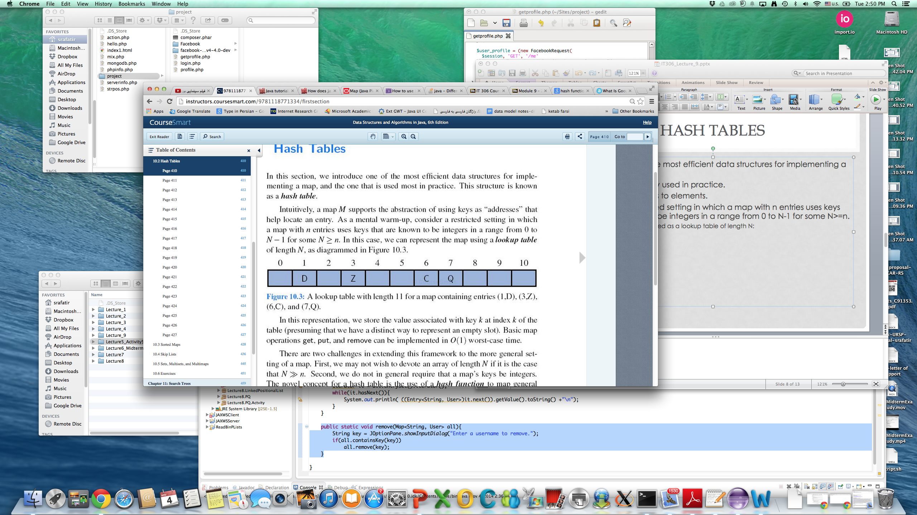
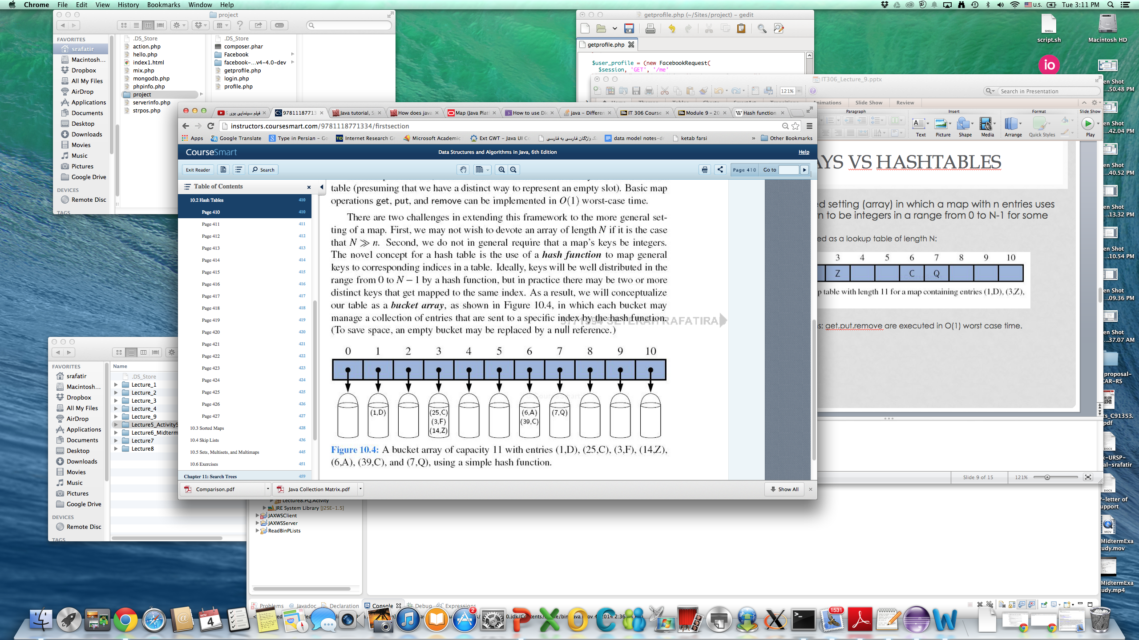
Arrays vs. Hashtables
Suppose a restricted setting (array) in which a map with n entries uses keys that are known to be integers in a range from 0 to N-1 for some N>=n.
This is represented as a lookup table of length N.
Basic map operations: get,put,remove are executed in O(1) worst case time.
Notes:
First, we may not wish to devote an array of length N if it is the case that N » n.
Second, we do not in general require that a map’s keys be integers. The novel concept for a hash table is the use of a hash function to map general keys to corresponding indices in a table. Ideally, keys will be well distributed in the range from 0 to N - 1 by a hash function, but in practice there may be two or more distinct keys that get mapped to the same index. As a result, we will conceptualize our table as a bucket array, as shown in Figure 10.4, in which each bucket may manage a collection of entries that are sent to a specific index by the hash function. ( To save space, an empty bucket may be replaced by a null reference.)

Slide 19
Hashtable vs. HashMap
Hashtable | HashMap
Does not allow null values | Allows null values
Supports key-value pair | Supports key-value pair
No ordering | No ordering
Does not allow duplicates | Does not allow duplicates
No upper bound | No upper bound
Synchronized | Unsynchronized
Members of Java Collection | Members of Java Collection
Synchronized means only one thread can modify a Hashtable at one point of time. Basically, it means that any thread before performing an update on a Hashtable will have to acquire a lock on the object while others will wait for lock to be released.

Slide 20
Applications of Maps
A university’s information system relies on some form of a student ID as a key that is mapped to that student’s associated record ( such as the student’s name, address, and course grades) serving as the value.
The domain- name system ( DNS) maps a host name, such as www.wiley.com , to an Internet- Protocol ( IP) address, such as 208.215.179.146.
A social media site typically relies on a ( nonnumeric) username as a key that can be efficiently mapped to a particular user’s associated information.
A company’s customer base may be stored as a map, with a customer’s ac-count number or unique user ID as a key, and a record with the customer’s information as a value. The map would allow a service representative to quickly access a customer’s record, given the key.
A computer graphics system may map a color name, such as turquoise , to the triple of numbers that describes the color’s RGB ( red- green- blue) representation, such as ( 64, 224, 208).

Slide 21
DNS Application Example
The domain- name system ( DNS) maps a host name, such as www.wiley.com , to an Internet- Protocol ( IP) address, such as 208.215.179.146.
Printing entryset....
www.wiley.com=208.215.179.146
http://localhost=127.0.0.0
www.google.com=64.233.160.0
Printing keyset......
www.wiley.com
http://localhost
www.google.com
import java.util.*;
public class DNSApplication {
public static void main(String[] args) {
Map<String,String> map = new HashTable<String, String>();
map.put("www.wiley.com" , "208.215.179.146");
map.put("http://localhost" , "127.0.0.0");
map.put("www.google.com" , "64.233.160.0");
map.put("www.google.com" , "64.233.160.0");
System.out.println("Printing entryset....");
Iterator it =null;
if(!map.isEmpty()){
it= map.entrySet().iterator();
while(it.hasNext()){
System.out.println(it.next());
}
System.out.println("\n\nPrinting keyset......");
it = map.keySet().iterator();
while(it.hasNext()){
System.out.println(it.next());
}
}}}

Slide 22
Social Media Example
public class User {
private String username;
private int userid;
private String phoneNumber;
private static int total;
public User(String username){
this.username= username;
total++;
userid=total;
}
public boolean setPhoneNumber(String phone){
if(phone.length()!=10) return false;
for(int i=0; i<phone.length(); i++){
if(!Character.isDigit(phone.charAt(i))) return false;
}
this.phoneNumber=phone;
return true;
}
public String getUsername(){ return username; }
public int getUserid() { return userid; }
public static int getTotal(){ return total; }
public String getPhoneNumber() {return phoneNumber; }
public String toString(){
return "Username: " + this.username + "\nUserid: "+this.userid + "\nphone number: "+ this.phoneNumber;
}}
A social media site typically relies on a ( nonnumeric) username as a key that can be efficiently mapped to a particular user’s associated information.

Slide 23
Social Media Example
import java.util.*;
import java.util.Map.Entry;
import javax.swing.JOptionPane;
public class SocialMediaUserApplication {
public static void main(String[] args) {
Map<String,User> all = new HashTable<String, User>();
User newUser = null;
while(JOptionPane.showConfirmDialog(null, "Add another user?")==JOptionPane.YES_OPTION){
newUser= getInput();
all.put(newUser.getUsername(),newUser);
}
System.out.println("Printing the content...");
displayAll(all);
System.out.println("\n\nRemoving the content....");
remove(all);
displayAll(all);
}
A social media site typically relies on a ( nonnumeric) username as a key that can be efficiently mapped to a particular user’s associated information.

Slide 24
Social Media Example
A social media site typically relies on a ( nonnumeric) username as a key that can be efficiently mapped to a particular user’s associated information.
public static User getInput(){
User user= new User(JOptionPane.showInputDialog("Enter a username."));
String phoneNumber="";
do{
phoneNumber=JOptionPane.showInputDialog("Enter a 10 digit phone number (XXXXXXXXXX)");
}while(!user.setPhoneNumber(phoneNumber));
return user;
}
public static void displayAll(Map<String, User> all){
Iterator it = all.entrySet().iterator();
while(it.hasNext()){
System.out.println( ((Entry<String, User>)it.next()).getValue().toString() +"\n");
}
}
public static void remove(Map<String, User> all){
String key = JOptionPane.showInputDialog("Enter a username to remove.");
if(all.containsKey(key))
all.remove(key);
}
}

Slide 25
Example Exercise
Student.java
UniversityApplication.java

